Slide 1
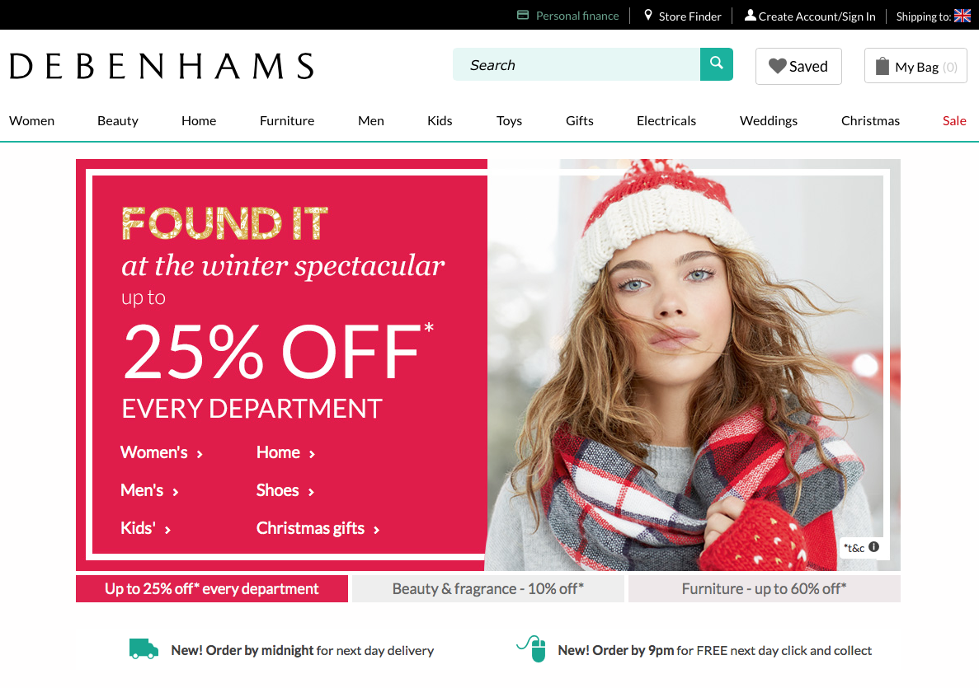

Slide 2
75% of the website is aimed at women.
25% of the website is aimed at men.
The way the website is organised shows us that it is easier for women to use.

Slide 3
Profiles
Celine
18
Has a part time job.
Looking for beauty products.
Often shops online for her clothes.
Dave
28
Account manager at a bank.
Looking for a suit for a wedding.
Rarely shops online, mainly in department stores.
Carol
38
Child minder.
Looking for kids toys.
Sometimes shops online.

Slide 4
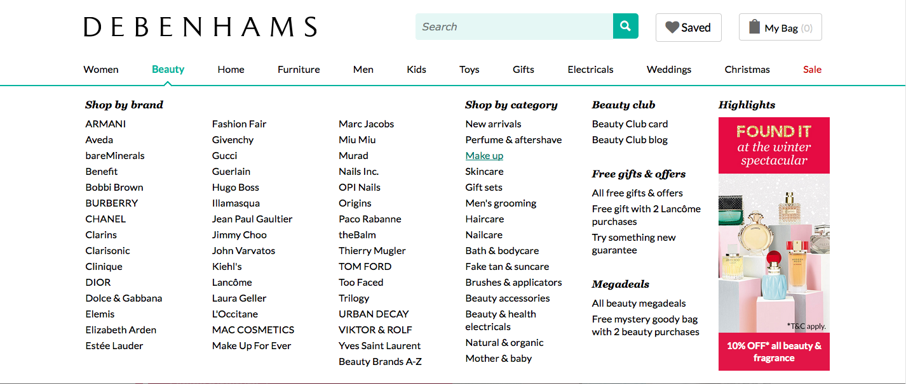
Steps to Research Make up
Hover over beauty tab and select Make up.

Slide 5
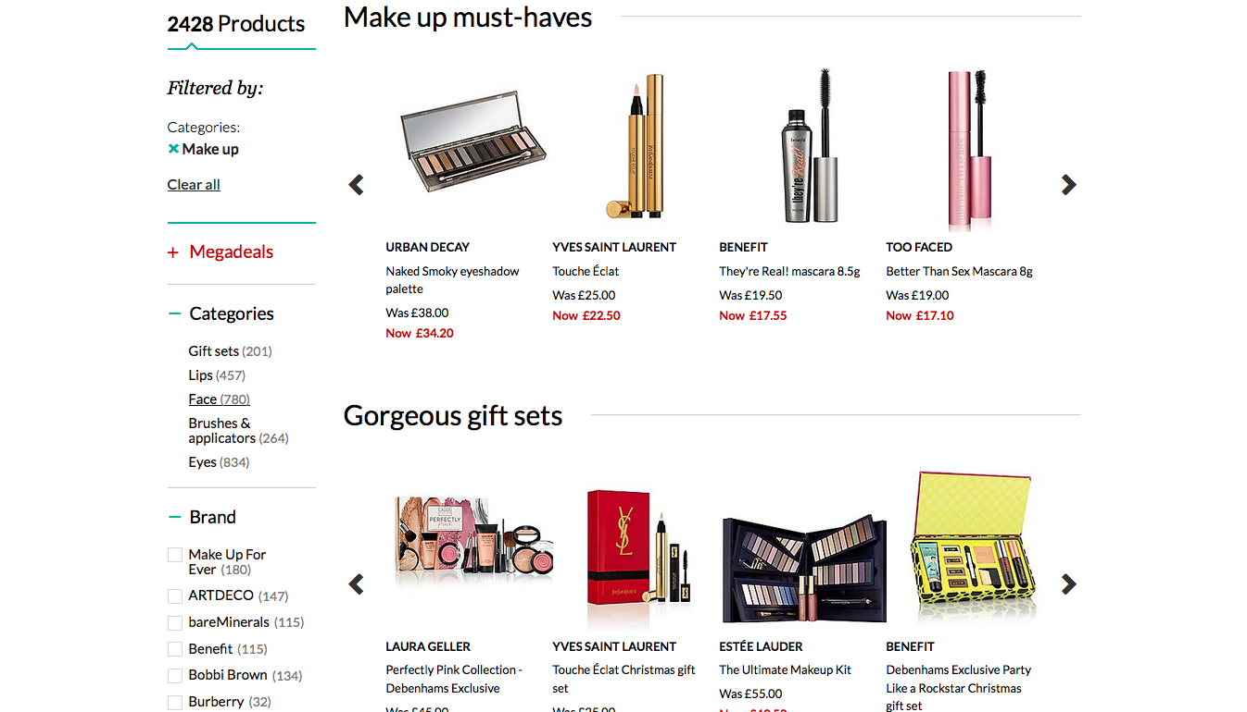
Steps to Research Make up
Scroll down to categories on the left hand side.

Slide 6
Steps to Research Make up
Click the face category.

Slide 7
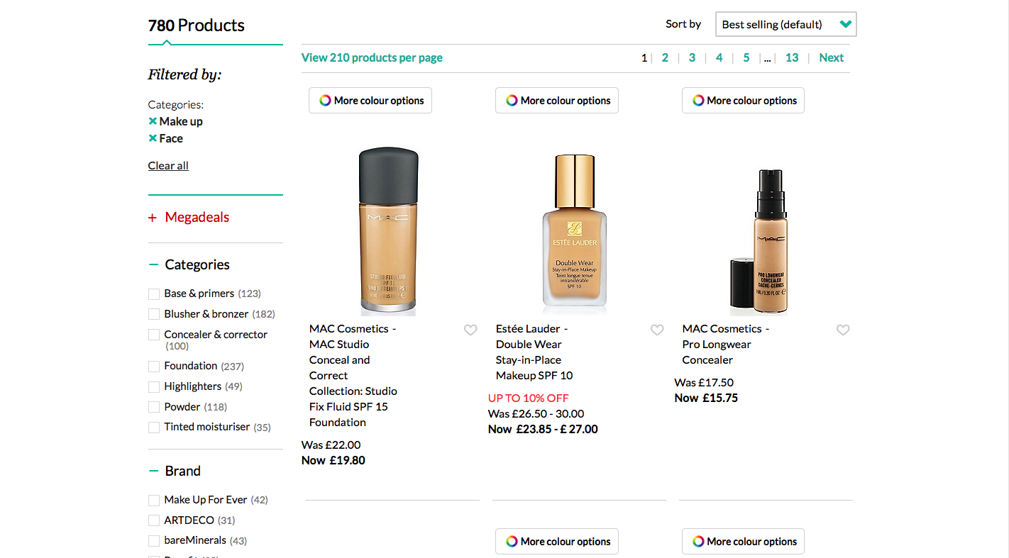
Steps to Research Make up
Filter to foundation.

Slide 8
Problems & Solutions
Problem: On each product it says ‘more colour options’ as a banner to make you think the colours may automatically come up when you hover or select it when it doesn’t do anything

Slide 9
Problems & Solutions
Solution: Create a setting so that it shows you the colour options. This is obviously a dead link/bug within the website. This also makes it easier to select the desired colour and click purchase.

Slide 10
Problems & Solutions
Problem: When clicking on the beauty tab at the top, it shows irrelevant information such as must haves instead of showing them important info such as categories.

Slide 11
Problems & Solutions
Solution: Move the categories section on the left to the top of the page and show them as clickable block categories.
Lips
Face
Eyes

Slide 12
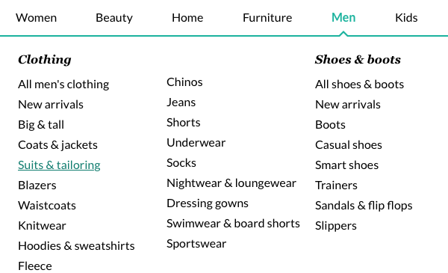
Steps to Buy a Suit
Hover over men tab and select Suits & Tailoring.

Slide 13
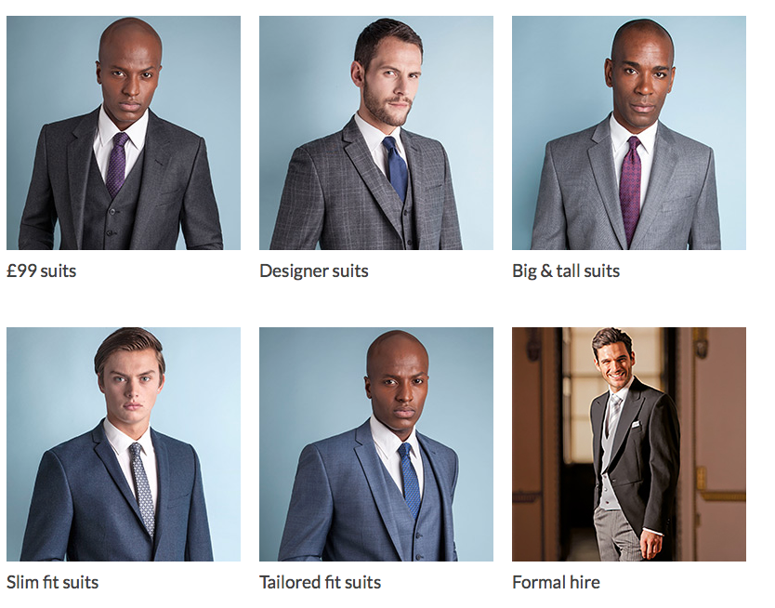
Steps to Buy a Suit
Select a suit category (Designer suits).

Slide 14
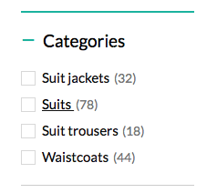
Steps to Buy a Suit
Under the category section, click on “Suits”.

Slide 15
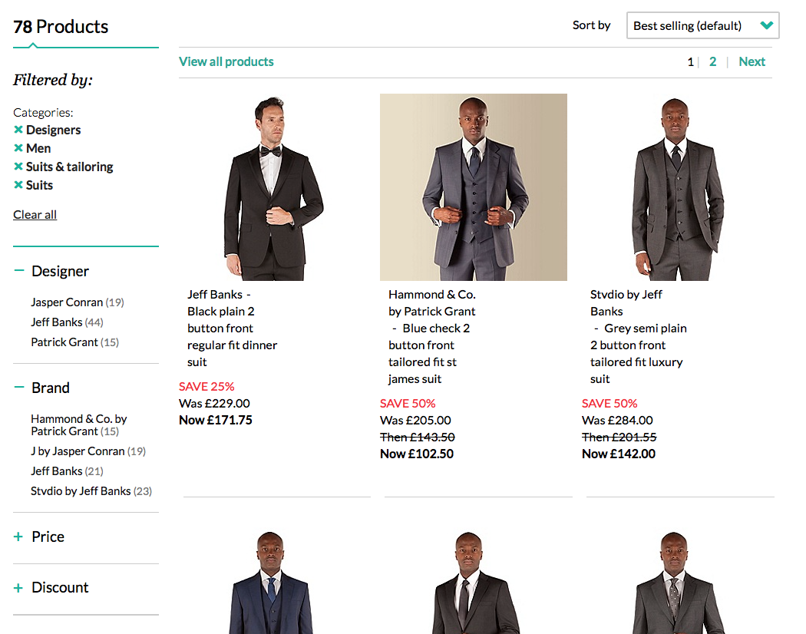
Steps to Buy a Suit
Select the required suit and process through checkout.

Slide 16
Problems & Solutions
Problem: There are no options to define the suits by colour, size or material anywhere under the suits section.
Solution: Include filters so that you can define the suits by colour, material and size so that it is easy for customers to select the required suit.

Slide 17
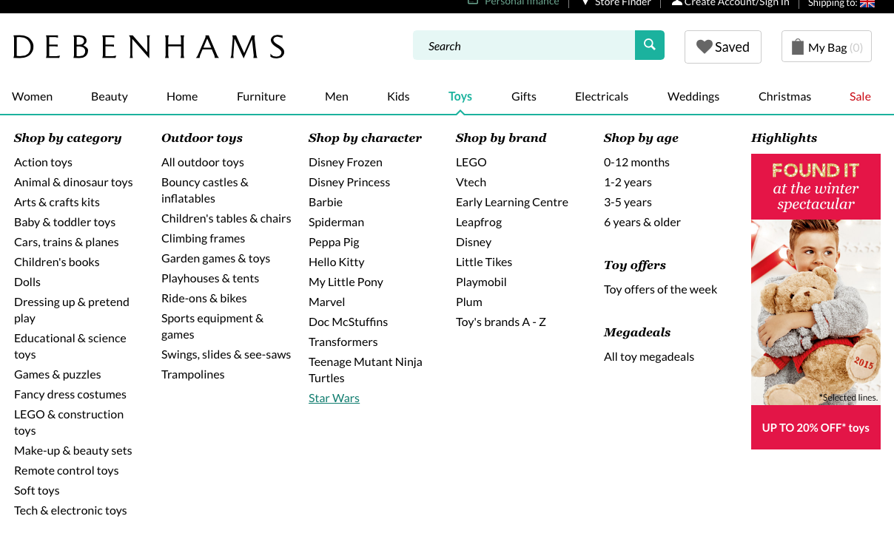
Steps to Buy a Toy
Hover over toys tab and select Star Wars.

Slide 18
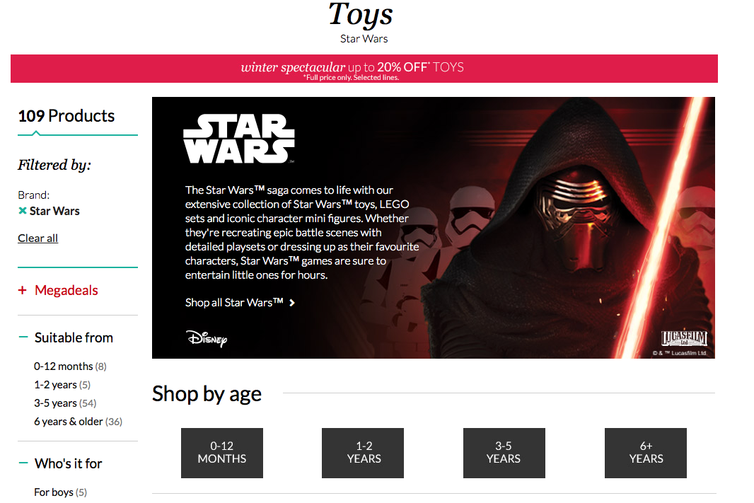
Steps to Buy a Toy
Click on 6+ years

Slide 19
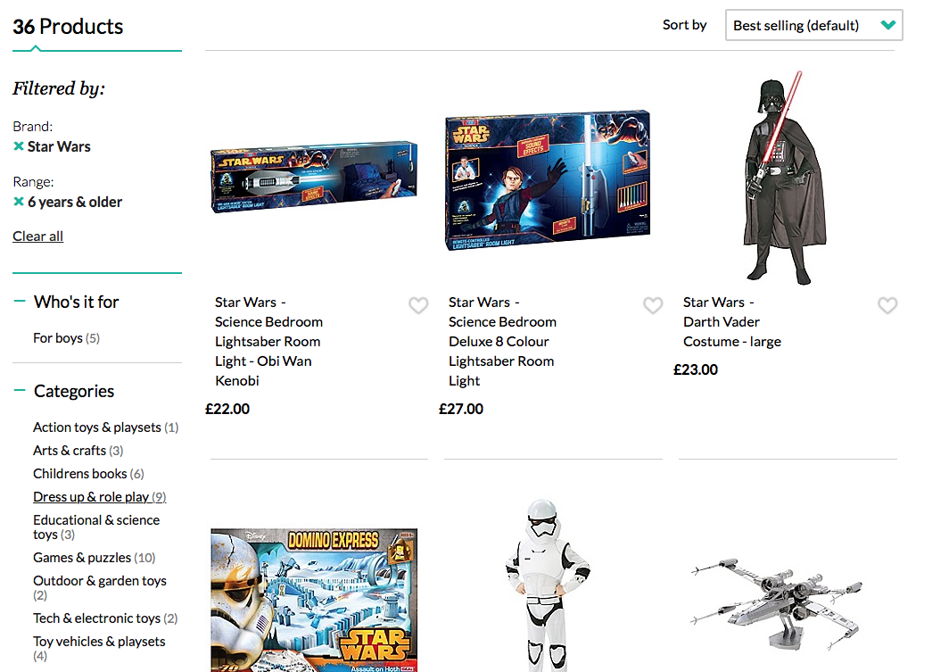
Steps to Buy a Toy
Then click on Dress up & role play.

Slide 20
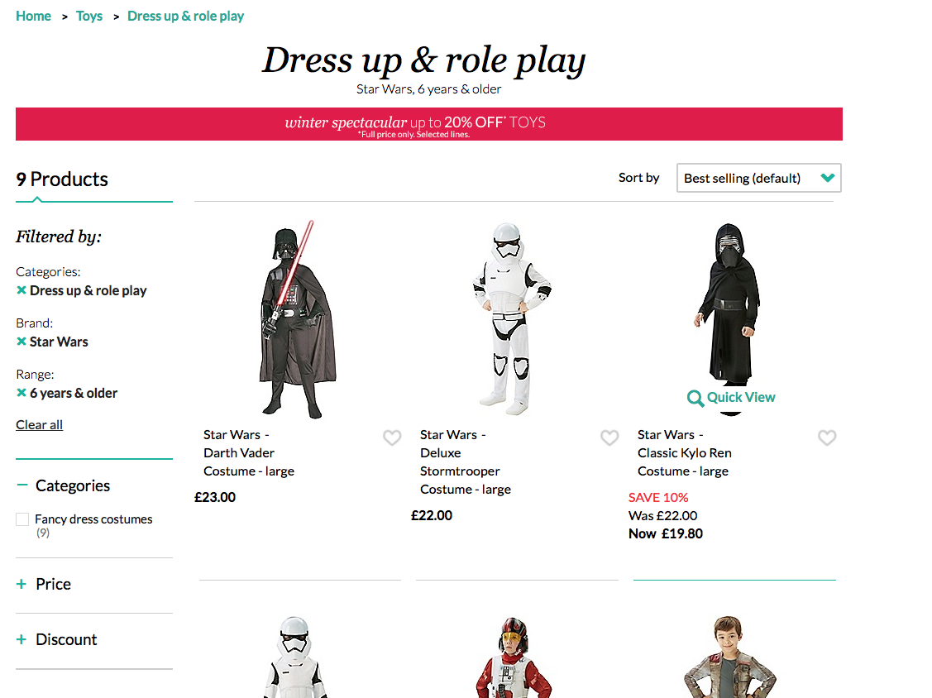
Steps to Buy a Toy
Then select your required product.

Slide 21
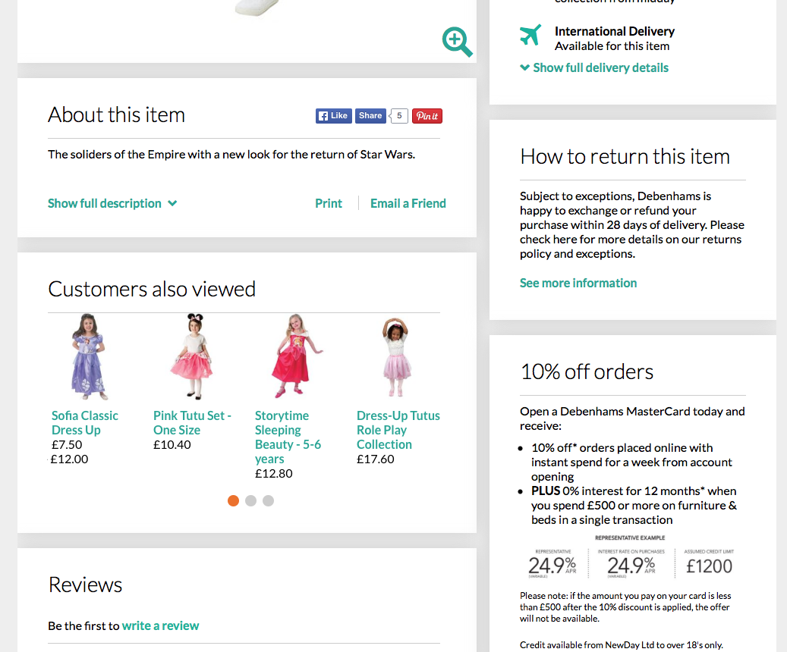
Problems & Solution
Problem: The suggested products are not relevant to the filtered products.
Solution: Include suggested products that relate to the filters applied beforehand.

